Slide 1

Architecture Design
DATA VISUALIZATION OF BIRD STRIKES BETWEEN
2000-2011
P R E P A R E D B Y
SOURAV KUMAR PANIGRAHI

Slide 2
Contents
Document Version Control
1. Introduction
1.1 What is Architecture Design Document?
1.2 Scope
2. Architecture
2.1 Power BI Architecture
2.2 Components of Power BI Architecture
3. Deployment
3.1 Power BI Deployment
3.2 Publish datasets and reports from Power BI Desktop

Slide 3
1. Introduction
1.1 What is Architecture Design Document?
Any software needs the architectural design to represent the design of the software. IEEE
defines architectural design as “the process of defining a collection of hardware and software
components and their interfaces to establish the framework for the development of a
computer system.” The software that is built for computer-based systems can exhibit one of
these many architectures.
Each style will describe a system category that consists of:
A set of components (eg: a database, computational modules) that will perform a function
required by the system.
The set of connectors will help in coordination, communication, and cooperation between
the components.
Conditions that how components can be integrated to form the system
Semantic models help the designer to understand the overall properties of the system.
1.2 What is Scope?
1.1 What is Architecture Design Document?
Architecture Design Document (ADD) is an architectural design process that follows a step-by-
step refinement process. The process can be used for designing data structures, required
software architecture, source code and ultimately, performance algorithms. Overall, the design
principles may be defined during requirement analysis and then refined during architectural
design work.
2. Architecture
2.1 Power BI Architecture
Power BI is a business suite that includes several technologies that work together. To deliver
outstanding business intelligence solutions. Microsoft Power BI technology consists of a group
of components such as:
a) Power Query (for data mash-up and transformation)
b) Power BI Desktop (a companion development tool)
c) Power BI Mobile (for Android, iOS, Windows phones)
d) Power Pivot (for in-memory tabular data modelling)
e) Power View (for viewing data visualizations)
f) Power Map (for visualizing 3D geo-spatial data)
g) Power Q&A (for natural language Q&A)

Slide 4
In simple terms, a Power BI user takes data from various data sources such as files, Azure source,
online services, Direct Query or gateway sources. Then, they work with that data on a client
development tool such as Power BI Desktop. Here, the imported data is cleaned and transformed
according to the user’s needs. Once the data is transformed and formatted, it is ready to use in
making visualizations in a report. A report is a collection of visualizations like graphs, charts, tables,
filters, and slicers.
2.2 Components of Power BI Architecture
1. Data Sources
An important component of Power BI is its vast range of data sources. You can import data
from files in your system, cloud-based online data sources or connect directly to live
connections. If you import from data on-premise or online services there is a limit of 1 GB.
Some commonly used data sources in Power BI are:
a) Excel
b) Text/CSV
c) XML
d) JSON
e) Oracle Database
f) IBM DB2 Database
g) MySQL Database
h) PostgreSQL Database
i) Sybase Database
j) Teradata Database
k) SAP HANA Database
l) SAP Business Warehouse server
m) Amazon Redshift
n) Impala
o) Google Big Query (Beta)
p) Azure SQL Database
q) Salesforce Reports
r) Google Analytics
s) Facebook
t) GitHub
2. Power BI Desktop
Power BI Desktop is a client-side tool known as a companion development and authoring tool.
This desktop-based software is loaded with tools and functionalities to connect to data
sources, transform data, data modelling and create reports.
3. Power BI Service
Power BI Service is a web-based platform from where you can share reports made on Power BI
Desktop, collaborate with other users, and create dashboards. It is available in three versions:
Free version
Pro version
Premium version

Slide 5
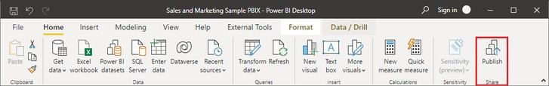
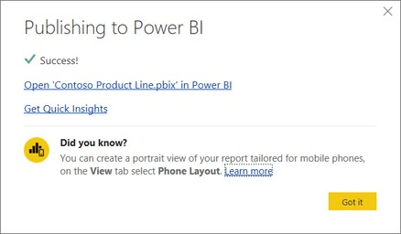
4. Power BI Report Server
The Power BI Report Server is similar to the Power BI Service. The only difference between
these two is that Power BI Report Server is an on-premise platform. It is used by organizations
who do not want to publish their reports on the cloud and are concerned about the security of
their data.
3. Deployment
3.1 Power BI Deployment
The deployment process lets you clone content from one stage in the pipeline to another,
typically from development to test, and from test to production. During deployment, Power BI
copies the content from the current stage, into the target one. The connections between the
copied items are kept during the copy process. Power BI also applies the configured
deployment rules to the updated content in the target stage. Deploying content may take a
while, depending on the number of items being deployed. During this time, you can navigate to
other pages in the Power BI portal, but you cannot use the content in the target stage.
3.2 Publish datasets and reports from Power BI Desktop
When you publish a Power BI Desktop file to the Power BI service, you publish the data in the
model to your Power BI workspace. The same is true for any reports you created in Report view.
You’ll see a new dataset with the same name, and any reports in your Workspace navigator.
Publishing from Power BI Desktop has the same effect as using Get Data in Power BI to connect
to and upload a Power BI Desktop file

Slide 6

THANK-YOU
P R E P A R E D B Y
SOURAV KUMAR PANIGRAHI

